Slide 1

Data Analyst Program
Class 4, Group 2
Final Project
December 2023

Slide 2
Group’s Members:
Eyal Vultz
Yoav Abadi
Oded Mark
Dan Dwek

Slide 3
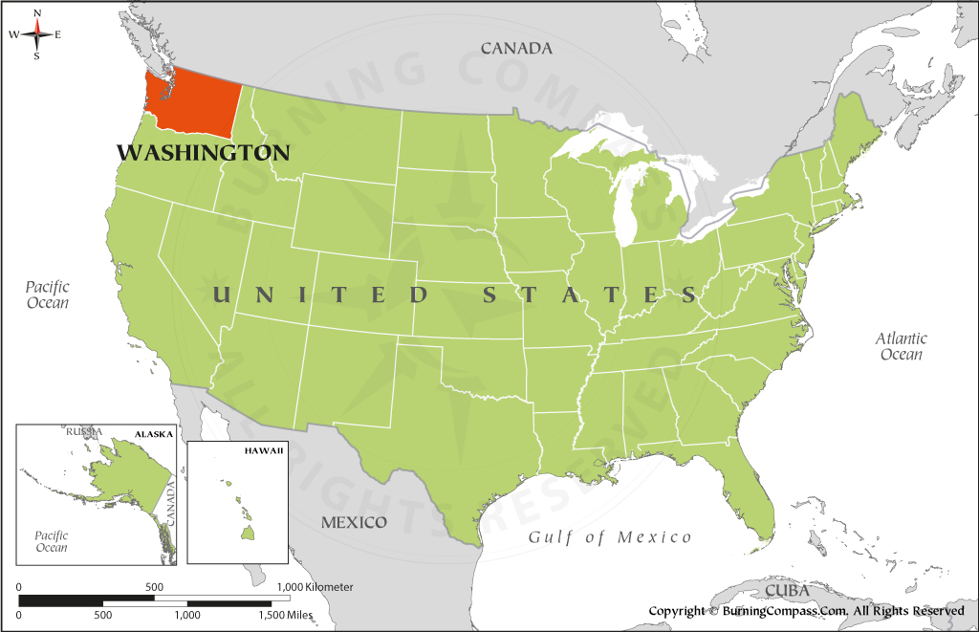

Data Analysis Goal:
Strategy guidance for a short-term investment in a property at Washington, United States.
Data Source:

Slide 4

KPI definition:
Analysis Strategy:
Characterization of properties with the highest probability to gain the highest Revenue in the Coming year*
*Elimination of the seasonality effect, while still being considered as a short-term period.
Forecasted Revenue in the Coming year = Price x (365 - availability_365)
Analysis Tool:

Slide 5
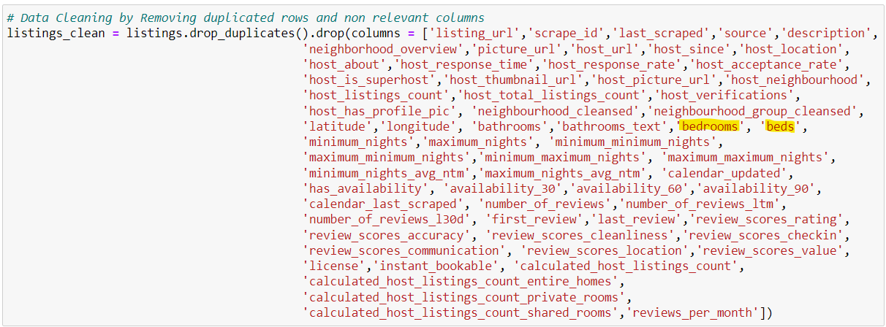
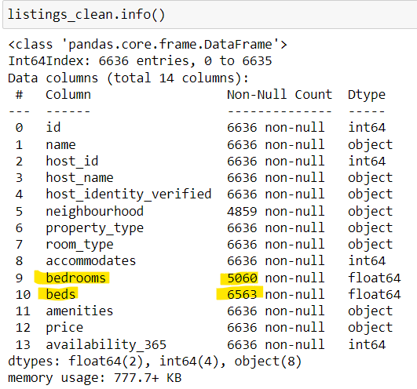
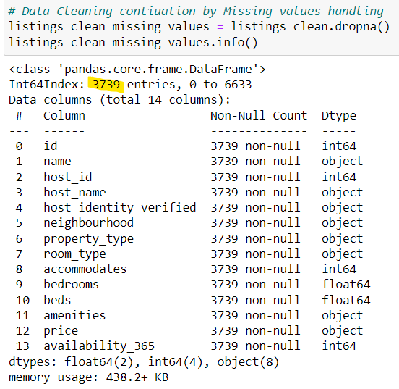
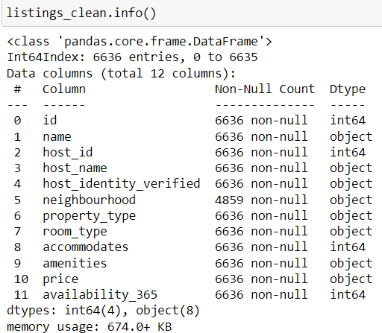
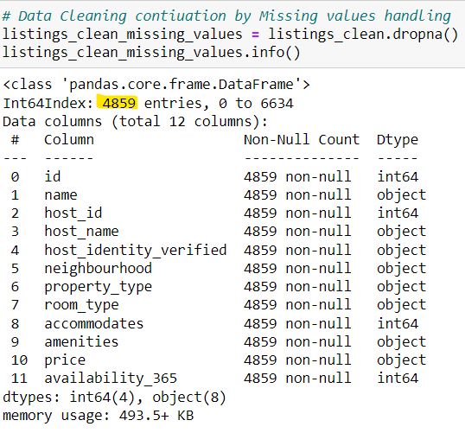
Data Cleaning:
1. Removing Duplicated records (rows) and irrelevant fields (columns) resulted also in null entries decrease:

Slide 6
Data Cleaning (cont.):
2. Filtration of only properties which are located in the state of Washington, based on the ‘neighborhood’ filed:
listings_clean_missing_values_Washington
= listings_clean_missing_values[listings_clean_missing_values['neighbourhood'].str.contains("Washington")]

Slide 7
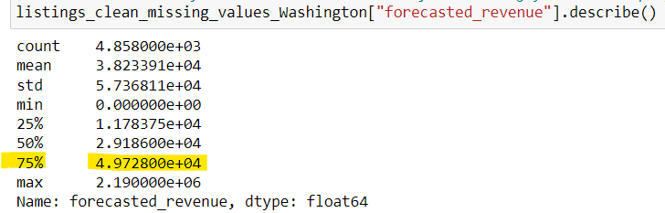
Data Analysis:
Stage A: Trial to specify the KPI’s filtered properties population Top 25% (Q1)

Slide 8
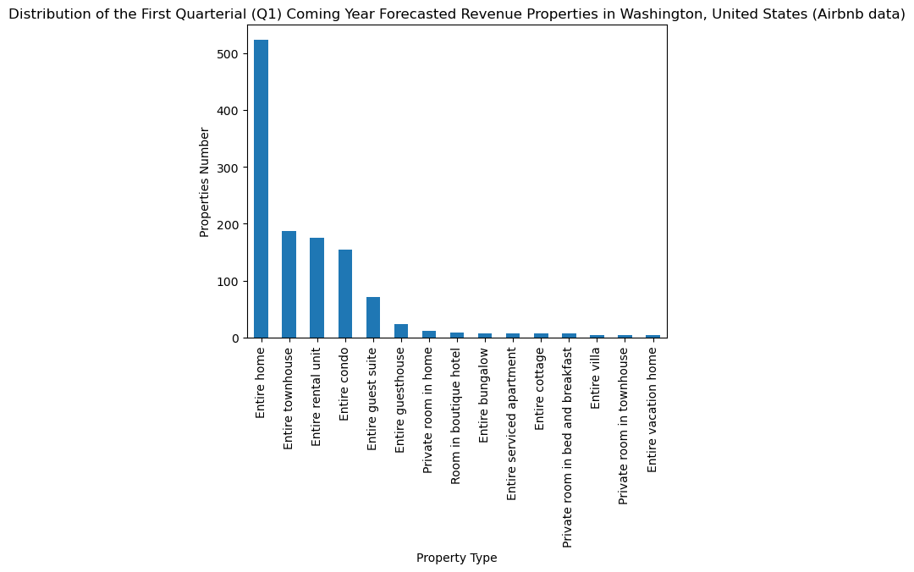
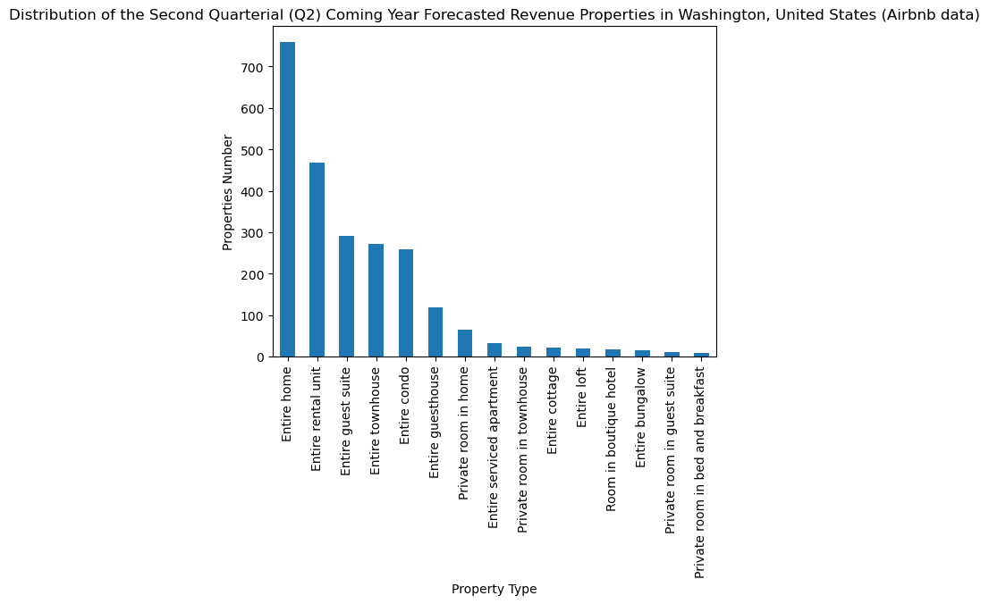
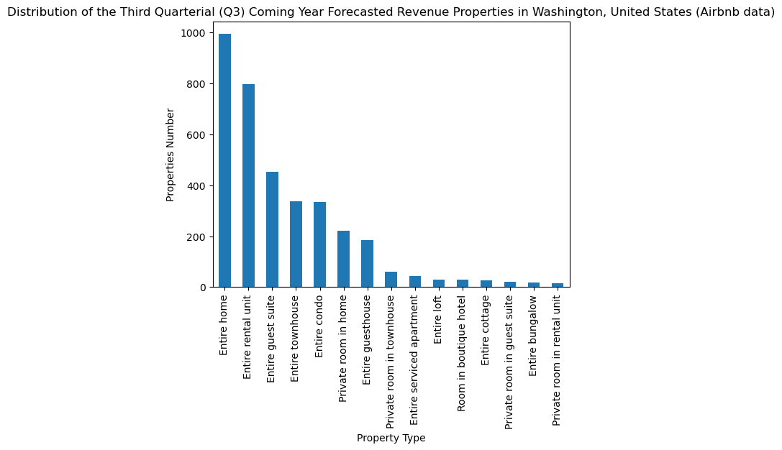
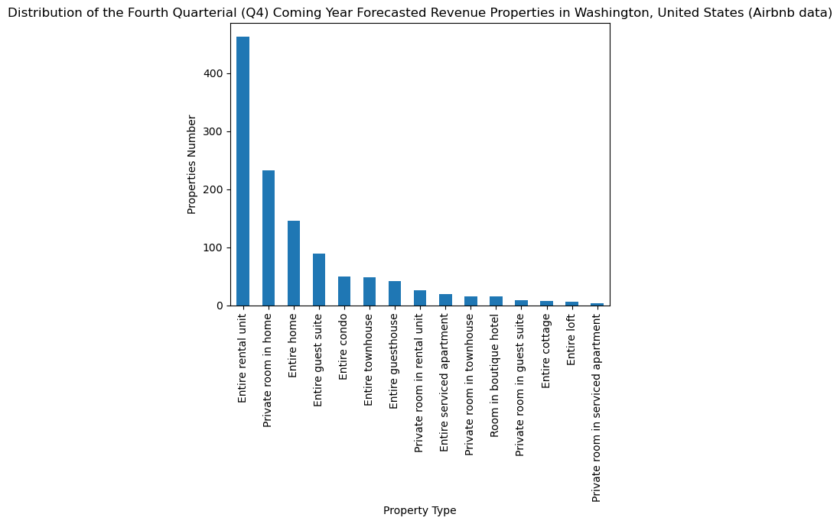
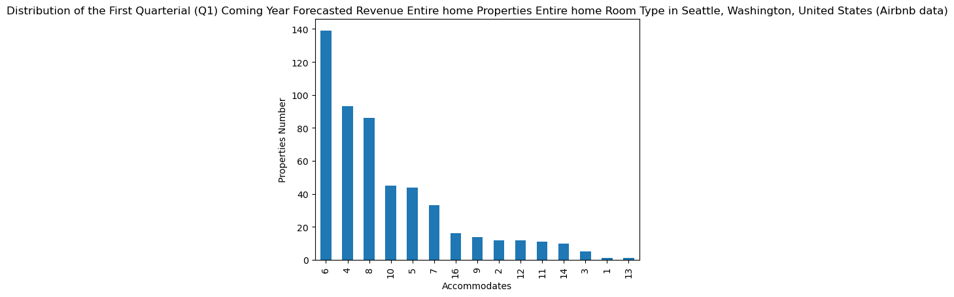

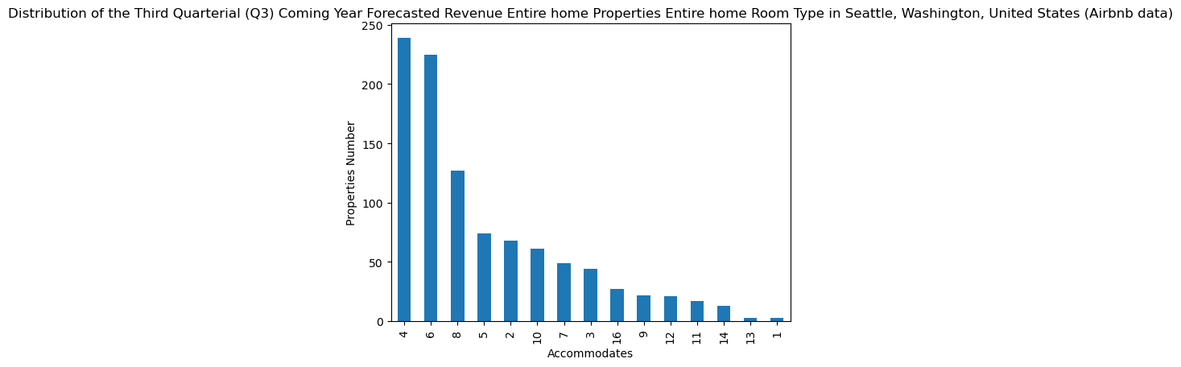
Data Analysis:
Stage A: resulted in insignificant outcomes

Slide 9
Data Analysis:
Stage A: resulted in insignificant outcomes
 | Q1 | Q2 | Q3 | Q4
Property Type | Entire home | Entire home | Entire home | Entire rental unit
Room Type | Entire home/apt | Entire home/apt | Entire home/apt
Neighborhood | Seattle | Seattle | Seattle
Accommodates | 6 | 6 | 4

Slide 10
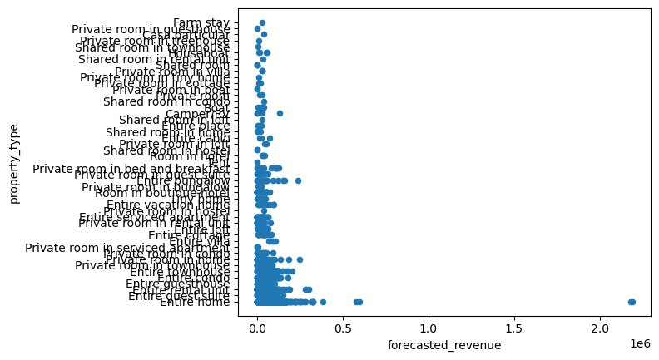
Data Analysis:
Stage B: Analyzing the entire filtered Properties’ population
Remark: The depended variable on the x-axis for convenience
Outliers

Slide 11
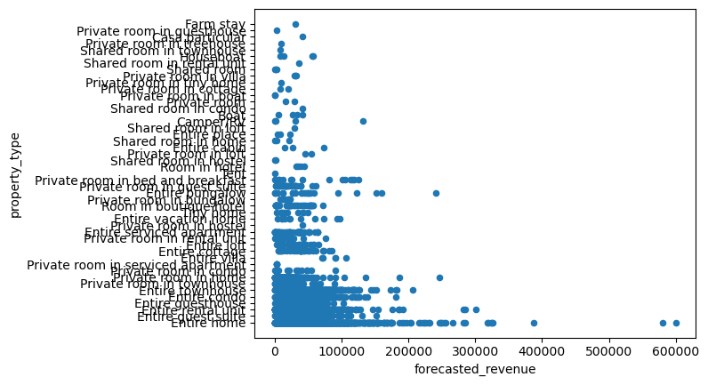
Data Analysis:
Stage B: Analyzing the entire filtered Properties’ population
Remark: The depended variable on the x-axis for convenience

Slide 12
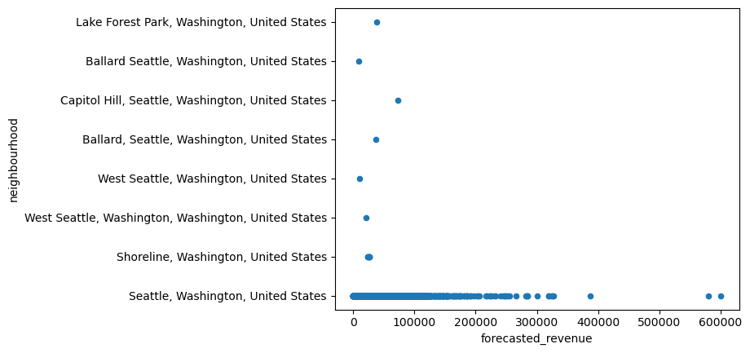
Data Analysis:
Stage B: Analyzing the entire filtered Properties’ population
Remark: The depended variable on the x-axis for convenience

Slide 13
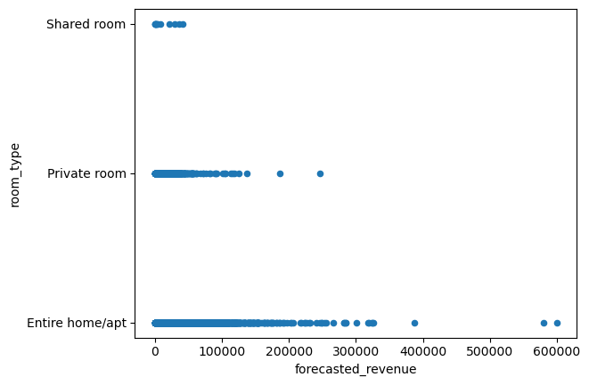
Data Analysis:
Stage B: Analyzing the entire filtered Properties’ population
Remark: The depended variable on the x-axis for convenience

Slide 14
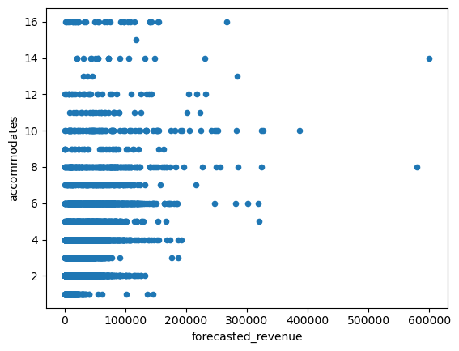
Data Analysis:
Stage B: Analyzing the entire filtered Properties’ population
Remark: The depended variable on the x-axis for convenience

Slide 15
Conclusion:
The properties with the highest Forecasted Revenue in Washington, United States in the coming year, according to Airbnb data are of Entire Home type, with Entire Home / Apartment room type, located in Seattle, and which are suitable to Accommodate 6 to 10 people.

Slide 16
Thank you for your attention!
Any Questions?

